Slide 1
Generative Adversarial Network (GANs)

Slide 2
Introduction
GANS - Generative Adversarial Networks
Introduced by lan Goodfellow and other researchers from the University of Montreal in 2014
It is a neural network that belongs to the set of generative Al
They are capable of generating new content that has never been generated before
GANS fall under the category of Unsupervised Learning
It can be applied to various domains such as images, music, speech, and writing
The architecture consists of two neural networks: the Generator and the Discriminator

Slide 3
The Evolution of GANs
It was a major breakthrough in the field of Deep Learning and Artificial Neural Networks.
Since its publication, it has remained one of the most popular and relevant topics within the field of Artificial Intelligence and Deep Learning.
It caused a significant advancement as until then other technologies were not achieving satisfactory results.
GANs came as a revolution, being the first to produce high-quality results on most of the datasets they were trained on.

Slide 4
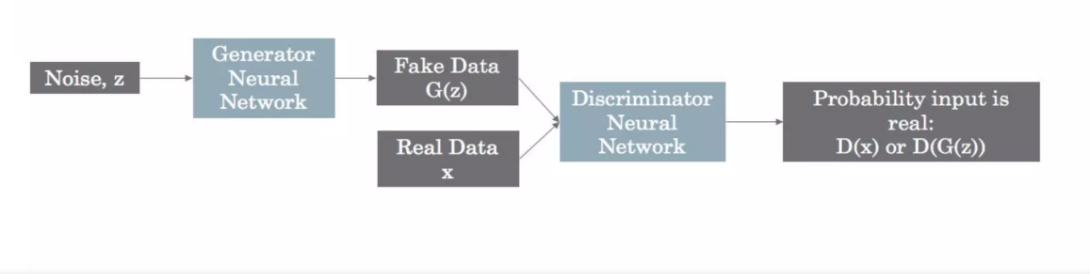
What are GANs
First network is called generator and it's basically responsible for creating new instances of data from random noise. Second network is called discriminator and it "judges" if the data generated by generator is real or fake having real data to compare.

Slide 5
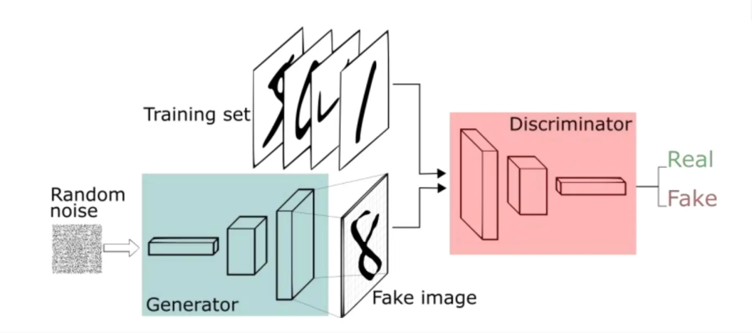
Steps of GANs

Slide 6
Steps of GANs
The Generator considers random values to generate an image-input.
The generated image is sent to the Discriminator along with a stream of images taken from the real dataset (to use as reference).
The Discriminator returns the probabilities of the generated image being real. The result is a number between 0 (fake) and 1 (authentic).

Slide 7
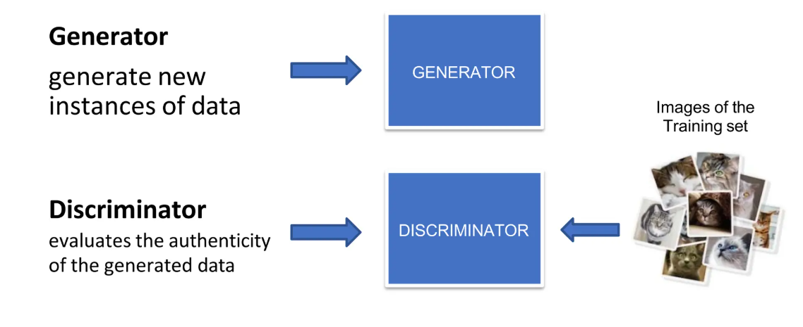
How GANs Work

Slide 8
How GANs Work
The discriminator network is a standard convolutional network (binary classifier that labels images as real or false).
The generator is the opposite: while the standard convolutional classifier takes the image and downsamples it to return a probability, the generator takes a random noise vector and upsamples it to generate an image that will be analyzed by the discriminator.
Both the discriminator and the generator are trying to optimize a different and opposite fitness function (loss function).
During training, the generator and the discriminator will change their behavior. • They will be one against the other because of the losses.
This is why we say that the two networks "compete" with each other.

Slide 9
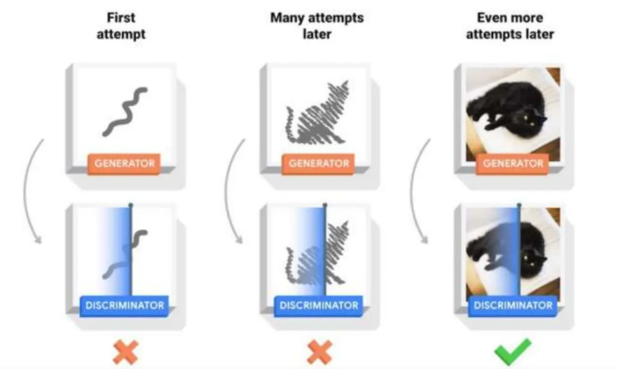
How GANs Work

Slide 10
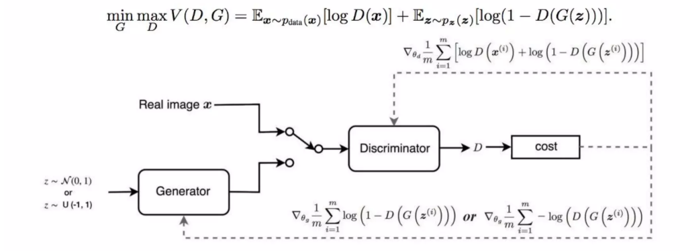
Why it is hard to train a GAN
There's no fixed minimum of a loss function (it changes in each iteration)
Discriminator gets too successful (vanishing gradient problem for generator)
Complicated goal:

Slide 11
Types of GANs
DCGANS (Deep Convolutional)
WGANS (Wasserstein)
SRGANS (Super resolution)
Pix2Pix (Image-to-image)
CycleGAN (Cycle Generative)
StackGAN (Stacked GAN)
ProGAN (Progressive Growing)
StyleGAN (Style-Based)
VQGAN (Vector Quantized)

Slide 12
Use Cases of GANs
"NVIDIA showed amazing example of this approach in action: they used GANS to augment dataset of medical brain CT images with different diseases and showed that the classification performance using only classic data augmentation yielded 78.6% sensitivity and 88.4% specificity. By adding the synthetic data augmentation the results increased to 85.7% sensitivity and 92.4% specificity."

Slide 13
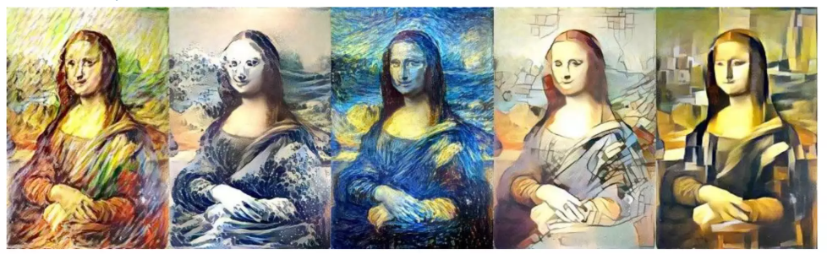
Use Cases of GANs
Data augmentation - e.g. create new instances of data to train your model, alternative to bayesian methods like Gibbs sampling
Image generation - e.g. Disney is generating new textures for animations •
Anomaly detection - GAN learns the predictor distribution so it can detect outliers and anomalies
Domain adaptation

Slide 14
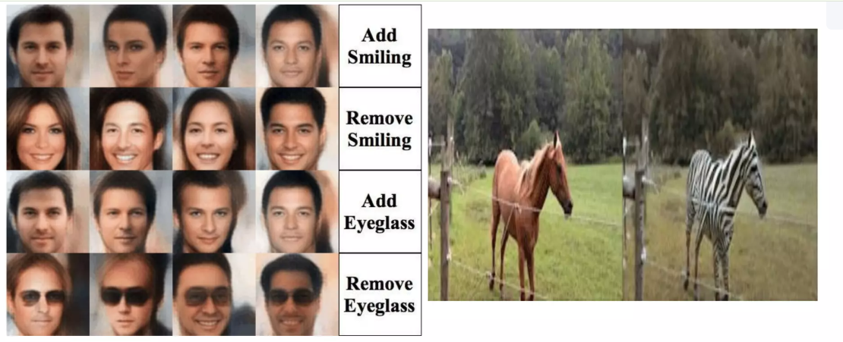
Use Cases of GANs
Data Manipulation

Slide 15
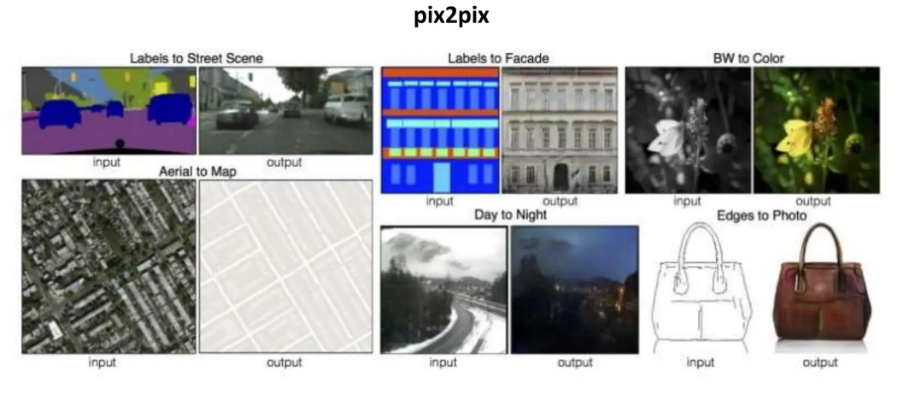
Use Cases of GANs
Paired Image to Image Translation

Slide 16
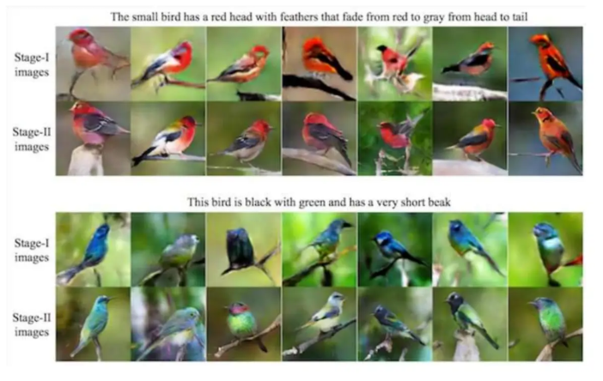
Use Cases of GANs
Text to Image Generation (Generating Synthetic Images from textual description)

Slide 17
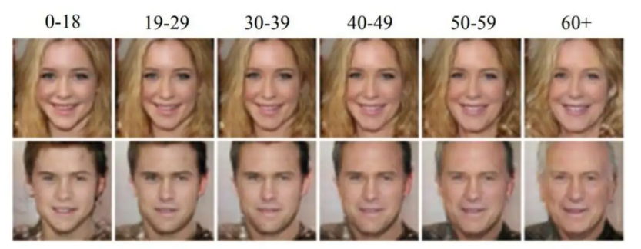
Use Cases of GANs
Facial Rejuvenation and Aging (and other facial operation such as adding a beard, changing expression, etc.)

Slide 18
An example of GAN implementation
Pix2Pix GAN
Pix2Pix is designed to learn a mapping from one image domain to another image domain
Pix2Pix leverages adversarial training
It's a conditional GAN (cGAN)
The paper "Image-to-Image Translation with Conditional Adversarial Networks" by Isola et al. was published in late 2016 and presented at CVPR 2017

Slide 19
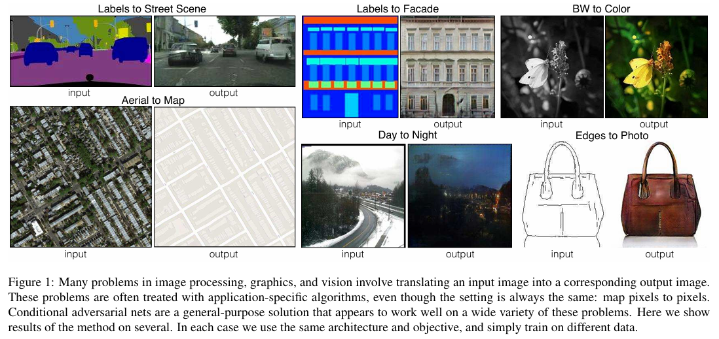
Pix2Pix GAN: Potential Use Cases

Slide 20
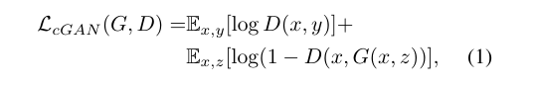
Pix2Pix GAN: Method -> conditional GAN
Here G tries to minimize this objective against an adversarial D that tries to maximize it

